Slide 1

Team Name : Code Crafters
Team Details – 1. Sanya Srivastava 2. Saloni College : Guru Nanak Dev Engineering College

Slide 2

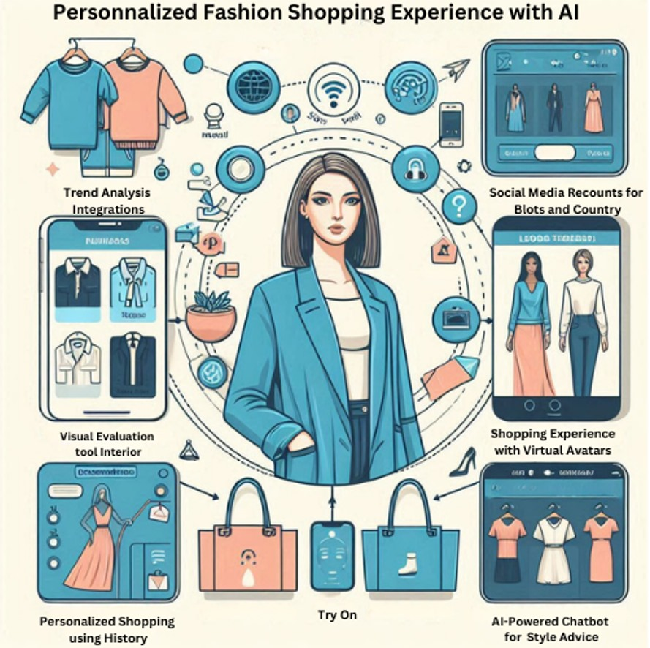


Transforming Fast Fashion: AI-Powered Recommendations, Virtual Styling and Enhanced Customer Engagement.
Idea/Approach Details
Idea Description
The Problem
Trend-Centric Recommendations: Employ AI-driven recommendation systems that analyze current fashion trends, customer preferences, and purchase history to deliver tailored product suggestions, enhancing customer engagement and conversion rates in the fast fashion segment
The Need
In the fast-paced world of fast fashion , and as a Gen-Z staying ahead of trends and meeting customer expectations is crucial. Gen-Z of today want personalized encounters that go with their own tastes and fashion sense.
Currently, recommendation systems frequently struggle to provide a completely customized shopping experience that enhances conversion rates and maintains customer engagement.
In order to tackle this issue, an advanced artificial intelligence (AI) recommendation system is essential, which not only evaluates current fashion trends but also utilizes client preferences and past purchases to deliver highly customized product recommendations.

Slide 3
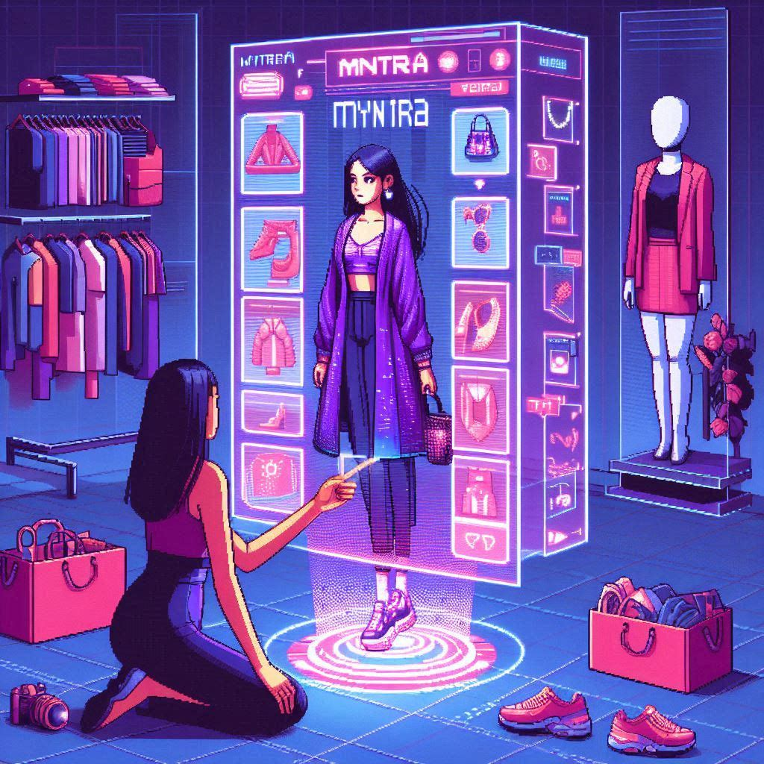

The Proposed Solution
In the rapidly evolving fashion sector, our solution utilizes cutting-edge AI technology to improve client interaction and increase conversion rates. Here's how:
Trend Analysis through Social Media Integration:
Utilize AI to monitor trends in fashion by keeping track on sites Example: Instagram Reels . Identify the latest and most popular patterns, colors, and style trends.
Customer Preferences and Purchase History: Utilize existing customer data in order to comprehend individual preferences, such as viewed products and purchase history.
Personalized Shopping Experience with Virtual Avatars: Introduce virtual avatars that customers can personalize to match their body shape and size . Allow customers to visualize how selected clothes would look on their avatars, enhancing confidence in their purchase decisions
AI-Powered Chatbot for Style Advice: Develop a chatbot that provides real-time assistance on how to pair clothing items together . Make recommendations based on individual preference choices and prevailing trends to add more interactivity and engagement to the purchasing experience.

Slide 4



User Journey :
Discovery Phase: Customer discovers trending fashion styles on Instagram Reels and other social media platforms.
Personalized Recommendation: AI analyzes trend data and customer preferences to suggest personalized fashion recommendations.
Virtual Avatar Customization: Customer creates a virtual avatar reflecting their body shape and size using intuitive tools on the shopping platform.
Visualizing Clothing Choices: Customer selects clothing items and instantly sees how they look on their personalized avatar in real-time 3D.
Engaging with AI Chatbot: Customer interacts with an AI chatbot for styling tips and advice based on their preferences and current trends.
Purchase Decision: Empowered by personalized recommendations and visualizations, the customer confidently makes a purchase directly on the platform.

Slide 5
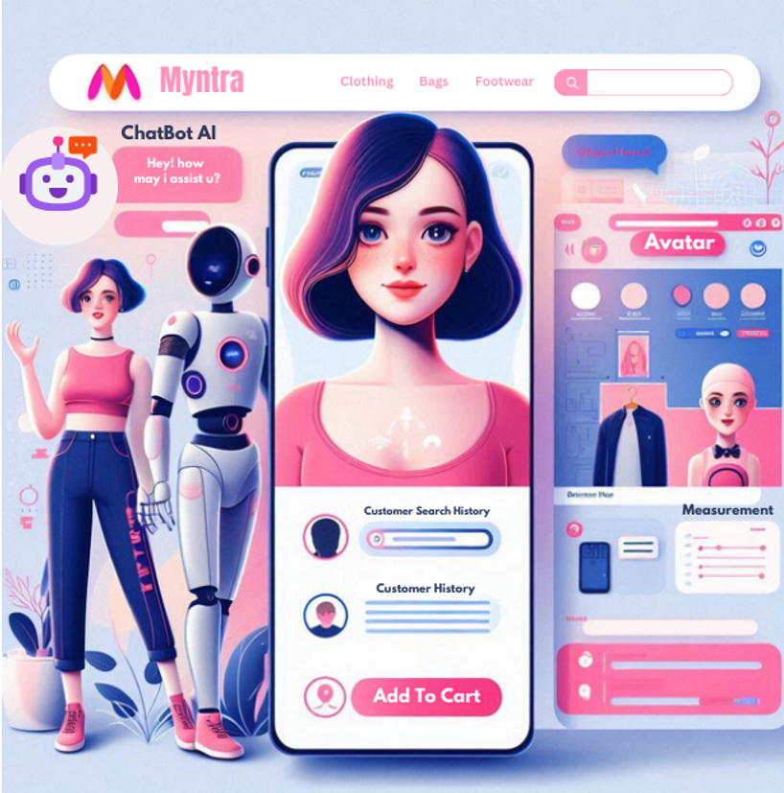
Sample Of Solution:

